Slide 1
CS347
Lecture 4
April 18, 2001
©Prabhakar Raghavan

Slide 2
Today’s topics
Computing cosine-based ranking
Speeding up cosine ranking
  reducing the number of cosine computations
    Union of term-wise candidates
    Sampling and pre-grouping
  reducing the number of dimensions
    Random projection
    Latent semantic indexing

Slide 3
Recall doc as vector
Each doc j is a vector of tf×idf values, one component for each term.
Can normalize to unit length.
So we have a vector space
  terms are axes
  docs live in this space
  even with stemming, may have 10000+ dimensions

Slide 4
Intuition
t 3
D2
D3
D1
x
y
t 1
t 2
D4
Postulate: Documents that are “close together”
in vector space talk about the same things.

Slide 5
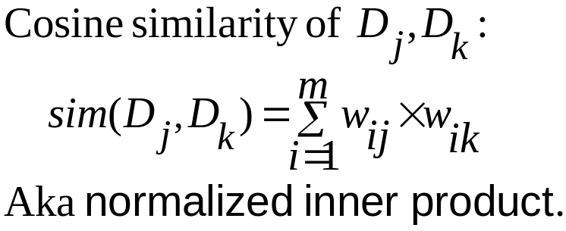
Cosine similarity
Can also compute cosine similarity from a query (vector
of terms, e.g., truth forever) to each document.

Slide 6
Exercises
How would you augment the inverted index built in lectures 1-3 to support cosine ranking computations?
Walk through the steps of serving a query.

Slide 7
Why use vector spaces?
Key: A user’s query can be viewed as a (very) short document.
Query becomes a vector in the same space as the docs.
Can measure each doc’s cosine proximity to query → ranking.

Slide 8
Efficient cosine ranking
Ranking consists of computing the k docs in the corpus “nearest” to the query ⇒k largest query-doc cosines.
Efficient ranking:
  Computing a single cosine efficiently.
  Choosing the k largest cosine values efficiently.

Slide 9
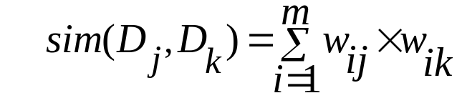
Computing a single cosine
For every term i, with each doc j, store term frequency tf_{ij}.
  Tradeoffs on whether to store term count, freq, or weighted by idf_{i}. (Coding possibilities.)
Accumulate component-wise sum
More on speeding up a single cosine, later in this lecture.

Slide 10
Computing the k largest cosines: selection vs. sorting
Typically we want to retrieve the top k docs (in the cosine ranking for the query)
  not totally order all docs in the corpus
  just pick off docs with k highest cosines.

Slide 11
Use heap for selecting top k
Binary tree in which each node’s value > values of children
Takes 2n operations to construct, then each of klog n “winners” read off in 2log n steps.
For n=1M, k=100, this is about 10% of the cost of sorting.

Slide 12
Bottleneck
Still need to first compute cosines from query to each of n docs → several seconds for n=1M.
Can select from only non-zero cosines; should be << 1M.

Slide 13
Can we avoid this?
Yes, but may occasionally get an answer wrong
  a doc not in the top k may creep into the answer.

Slide 14
Term-wise candidates
Preprocess: Pre-compute, for each term, its k nearest docs.
  (Treat each term as a 1-term query.)
  lots of preprocessing.
  Result: “preferred list” for each term.
Search:
  For a t-term query, take the union of their t preferred lists - call this set S.
  Compute cosines from the query to only the docs in S, and choose top k.

Slide 15
Exercises
Fill in the details of the calculation:
  Which docs go into the preferred list for a term?
Devise a small example where this method gives an incorrect ranking.

Slide 16
Sampling and pre-grouping
First run a pre-processing phase:
  pick √n docs at random: call these leaders
  For each other doc, pre-compute nearest leader
    Docs attached to a leader: its followers;
    Likely: each leader has ~ √n followers.
Process a query as follows:
  Given query Q, find its nearest leader L.
  Seek k nearest docs from among L’s followers.

Slide 17
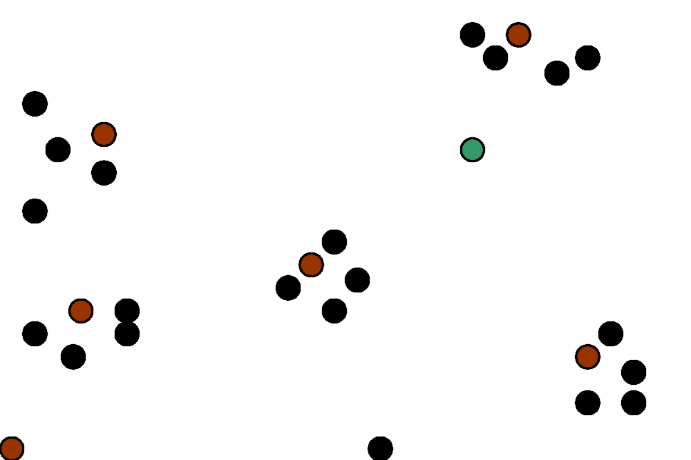
Visualization
Query
Leader
Follower

Slide 18
Why use random sampling
Fast
Leaders reflect data distribution

Slide 19
General variants
Have each follower attached to a=3 (say) nearest leaders.
From query, find b=4 (say) nearest leaders and their followers.
Can recur on leader/follower construction.

Slide 20
Exercises
To find the nearest leader in step 1, how many cosine computations do we do?
What is the effect of the constants a,b on the previous slide?
Devise an example where this is likely to fail - we miss one of the k nearest docs.
  Likely under random sampling.

Slide 21
Dimensionality reduction
What if we could take our vectors and “pack” them into fewer dimensions (say 10000→100) while preserving distances?
(Well, almost.)
  Speeds up cosine computations.
Two methods:
  Random projection.
  “Latent semantic indexing”.

Slide 22
Random projection onto k<<m axes.
Choose a random direction x₁ in the vector space.
For i = 2 to k,
  Choose a random direction x_{i} that is orthogonal to x₁, x₂, … x_{i-1}.
Project each doc vector into the subspace x₁, x₂, … x_{k}.

Slide 23
E.g., from 3 to 2 dimensions
t ₃
D2
x₂
x₂
D2
D1
D1
t ₁
x₁
x₁
t ₂
x₁ is a random direction in (t₁,t₂,t₃) space.
x₂ is chosen randomly but orthogonal to x₁.

Slide 24
Guarantee
With high probability, relative distances are (approximately) preserved by projection.
Pointer to precise theorem in Resources.

Slide 25
Computing the random projection
Projecting n vectors from m dimensions down to k dimensions:
  Start with m × n matrix of terms × docs, A.
  Find random k × m orthogonal projection matrix R.
  Compute matrix product W = R × A.
jth column of W is the vector corresponding to doc j, but now in k << m dimensions.

Slide 26
Cost of computation
This takes a total of kmn multiplications.
Expensive - see Resources for ways to do essentially the same thing, quicker.
Exercise: by projecting from 10000 dimensions down to 100, are we really going to make each cosine computation faster?
Why?

Slide 27
Latent semantic indexing (LSI)
Another technique for dimension reduction
Random projection was data-independent
LSI on the other hand is data-dependent
  Eliminate redundant axes
  Pull together “related” axes
    car and automobile

Slide 28
Notions from linear algebra
Matrix, vector
Matrix transpose and product
Rank
Eigenvalues and eigenvectors.

Slide 29
Overview of LSI
Pre-process docs using a technique from linear algebra called Singular Value Decomposition.
Have control over the granularity of this process:
  create new vector space, details to follow.
Queries handled in this new vector space.

Slide 30
Singular-Value Decomposition
Recall m × n matrix of terms × docs, A.
  A has rank r ≤ m,n.
Define term-term correlation matrix T=AA^{t}
  A^{t} denotes the matrix transpose of A.
  T is a square, symmetric m × m matrix.
Doc-doc correlation matrix D=A^{t}A.
  D is a square, symmetric n × n matrix.
Why?

Slide 31
Eigenvectors
Denote by P the m × r matrix of eigenvectors of T.
Denote by R the n × r matrix of eigenvectors of D.
It turns out A can be expressed (decomposed) as A = PQR^{t}
  Q is a diagonal matrix with the eigenvalues of AA^{t} in sorted order.

Slide 32
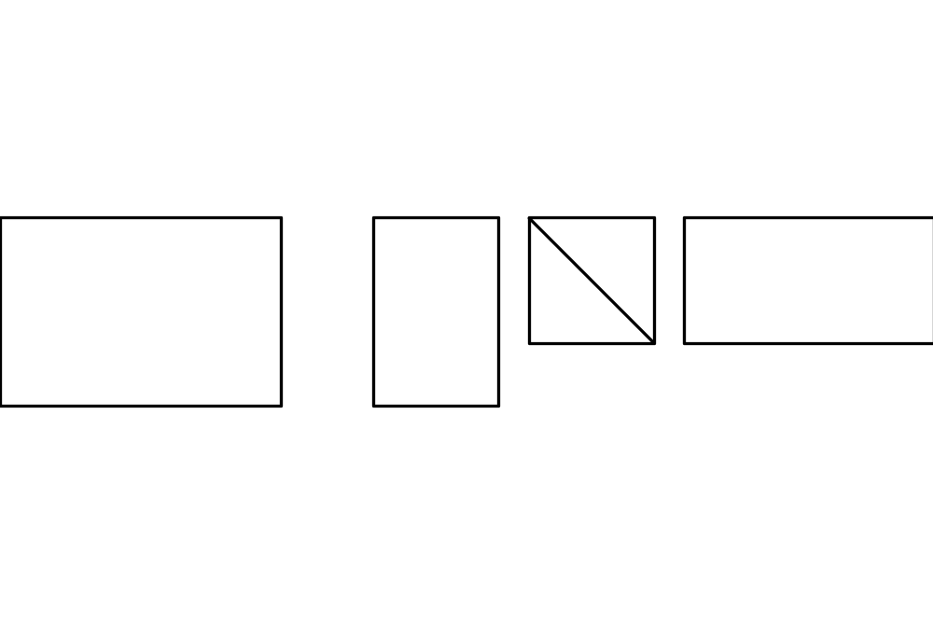
Visualization
m×n
=
m×r
r×r
r×n
A
P
Q
R^{t}

Slide 33
Dimension reduction
For some s << r, zero out all but the s biggest eigenvalues in Q.
  Denote by Q_{s} this new version of Q.
  Typically s in the hundreds while r could be in the (tens of) thousands.
Let A_{s} = P Q_{s} R^{t}
Turns out A_{s} is a pretty good approximation to A.
We’ll explain
what this means.

Slide 34
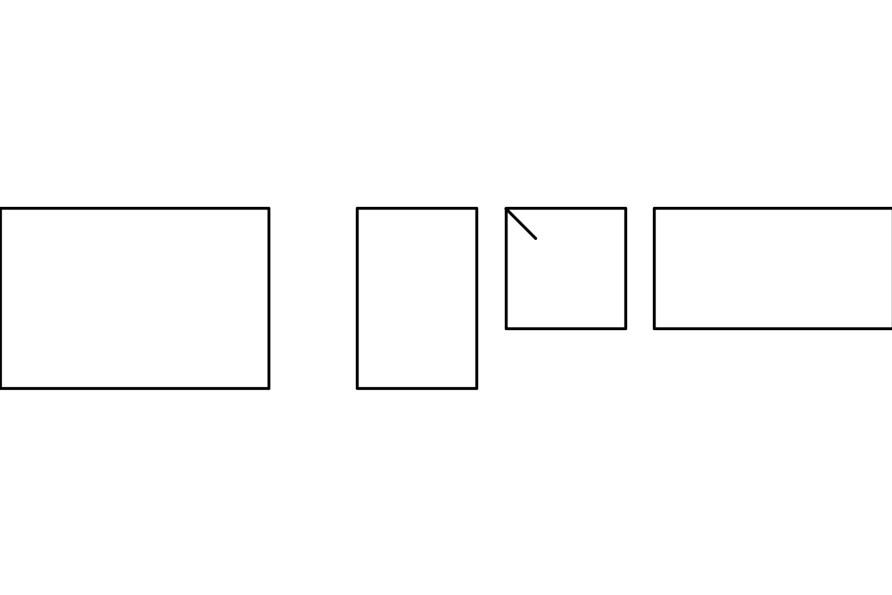
Visualization
0
=
0
0
A_{s}
P
Q_{s}
R^{t}
The columns of A_{s} represent the docs, but in s<<m dimensions.

Slide 35
Guarantee
Relative distances are (approximately) preserved by projection:
  Of all m × n rank s matrices, A_{s} is the best approximation to A.
Pointer to precise theorem in Resources.

Slide 36
Doc-doc similarities
A_{s} A_{s}^{t} is a matrix of doc-doc similarities:
  the (j,k) entry is a measure of the similarity of doc j to doc k.

Slide 37
Semi-precise intuition
We accomplish more than dimension reduction here:
  Docs with lots of overlapping terms stay together
  Terms from these docs also get pulled together.
Thus car and automobile get pulled together because both co-occur in docs with tires, radiator, cylinder, etc.

Slide 38
Query processing
View a query as a (short) doc:
  call it row 0 of A_{s}.
Now the entries in row 0 of A_{s} A_{s}^{t} give the similarities of the query with each doc.
Entry (0,j) is the score of doc j on the query.
Exercise: fill in the details of scoring/ranking.

Slide 39
Resources
Random projection theorem: http://citeseer.nj.nec.com/dasgupta99elementary.html
Faster random projection: http://citeseer.nj.nec.com/frieze98fast.html
Latent semantic indexing: http://citeseer.nj.nec.com/deerwester90indexing.html
Books: MG 4.6, MIR 2.7.2.

